Slide 1


Sudoku Maker & Solver
A project by Harnoor Singh Siyan to create and solve Sudoku puzzles. It combines algorithmic design with programming skills to generate and solve puzzles efficiently.
by Professor Paradox

Slide 2

Acknowledgments
1
Supervisor
2
Peers
Gratitude to Aman Kumar for guidance and support throughout the project.
Thanks to peers for collaboration and camaraderie during development.
3
Resources
Acknowledgment of programming libraries and online forums that aided the project.

Slide 3
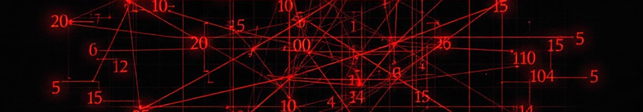
Project Overview
Purpose
1
Create a tool for generating and solving Sudoku puzzles.
2
Methodology
Employ backtracking algorithms and constraint satisfaction techniques.
Results
3
Successfully generate puzzles of varying difficulty and solve them efficiently.

Slide 4
Introduction to Sudoku
Origins
Objective
Benefits
Evolved from a 19th-century number placement game.
Fill 9x9 grid with digits 1-9 in each row, column, and subgrid.
Enhances critical thinking, strategic planning, and problem-solving skills.

Slide 5
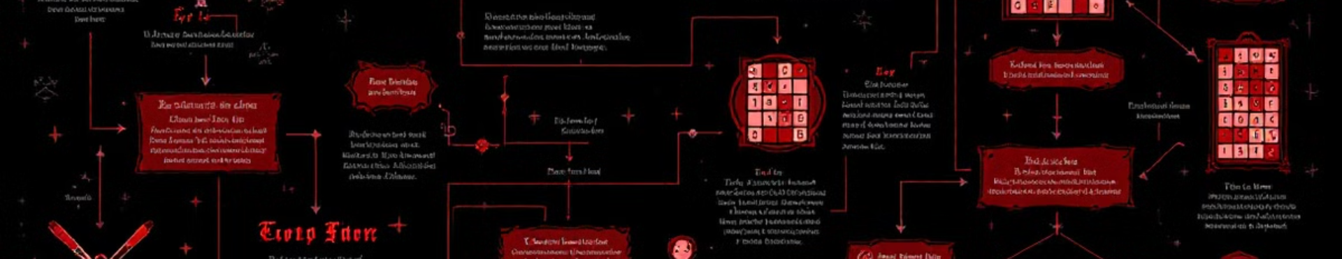
Project Objectives
Grid Generation
Puzzle Creation
Solver Implementation
Develop algorithm to create valid 9x9 Sudoku grids.
Generate playable puzzles with varying difficulty levels.
Create efficient backtracking algorithm to solve puzzles.

Slide 6





Application Tools
Python
Tkinter
Core programming language for development.
GUI toolkit for creating the user interface.
PyCharm
Git
Integrated Development Environment for coding.
Version control system for managing code changes.

Slide 7





System Architecture
Grid Initialization
Create complete 9x9 Sudoku grid using backtracking.
Validation
Ensure grid complies with Sudoku rules.
Puzzle Creation
Remove numbers to create playable puzzles.
Solving
Implement backtracking algorithm to solve puzzles.

Slide 8
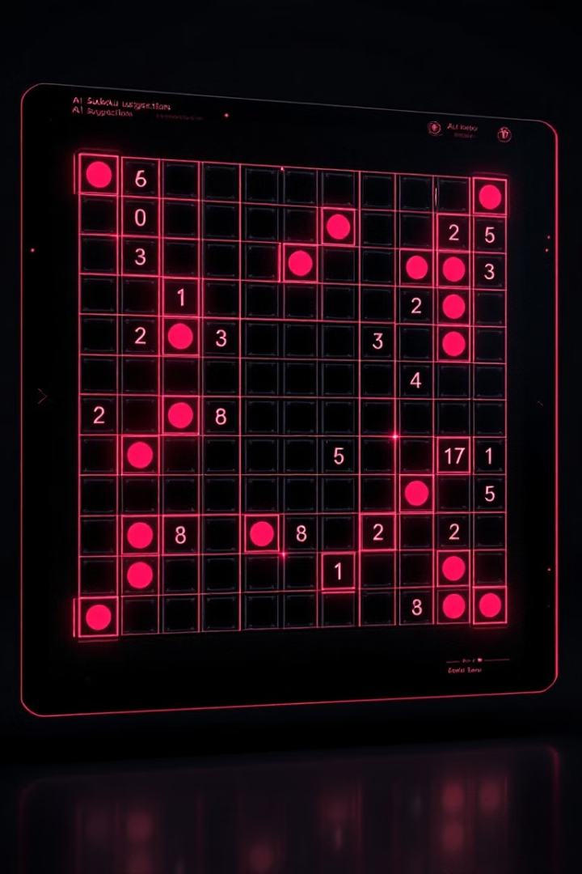
Conclusion and Future Work
Achievements
Future Improvements
Efficient puzzle generation
Advanced solving techniques
User-friendly interface
Customizable difficulty settings
Practical algorithmic application
Machine learning integration

